Slide 1

DATABASE FOR UNIVERSITY OF GHANA
FOR BOTH WEB AND MOBILE APPLICATONS

Slide 2

COURSE CODE AND TITLE: CPEN 211 DATABASE SYSTEM DESIGN
COURSE INSTRUCTOR: JOHN KORANKYE ASSIAMAH
PROJECT 3

Slide 3
GROUP 1
LAWERTEH DANSO MICHEAL - 10956332
DOE AGUDEY DANIEL - 10956661
ACQUAH EDWARD AYIREBI - 10986982
DANSO TWUM KWADJO - 10947466
ACQUAAH-ARHIN ABBA - 10957499
EYIRAM ABA AGBORSON - 10955078
WURAPA LARRY KWABENA - 10966173

Slide 4
OBJECTIVE
The main objective of this project is to automate some of the key activities in Engineering School at the University of Ghana. Specifically, the project aims to automate the following activities:
Capturing student details every year
Registering courses
Registering for examinations
Printing registered courses
Printing examination results
Adding a time table
Creating an exam time table

Slide 5

PURPOSE OF THE DATABASE
The project will develop a database for both web and mobile applications to accomplish these objectives. The database will be used to store and manage student details, courses, lecturers, examinations, and other key data.

Slide 6
KEY GOALS OF THE DATABASE
The key goals of the project include improving efficiency and accuracy of these activities, reducing errors and delays associated with manual data entry and processing, and providing a centralized and accessible database for all stakeholders in Engineering School. Additionally, the project aims to:
Provide a user-friendly interface for data entry and retrieval
Ensure data security and integrity
Enhance reporting and analysis capabilities to support decision-making processes
Improve the overall management of academic activities in Engineering School.

Slide 7
BACKGROUND INFORMATION ABOUT THE UNIVERSITY
Engineering School at the University of Ghana offers various undergraduate and graduate programs in fields like agricultural, biomedical, food process, materials, and computer engineering.
However, many key activities such as capturing student details, registering courses and examinations, are done manually, leading to errors and delays.
As the school grows, the need for automation has become increasingly important.
SOLUTION: The solution is to develop a database for web and mobile applications that improves data management, reduces errors, and provides a more efficient and effective service to students and staff.

Slide 8
SCOPE OF THE PROJECT
This project will automate tasks like capturing student details, registering courses, and printing examination results in Engineering School at the University of Ghana.
This will improve efficiency and accuracy, making things easier for students and staff.
DURATION OF PROJECT: The project took six two weeks, with three phases: planning, implementation, and testing.
CONSTRAINTS AND CHALLENGES: The team needed to deal with challenges like limited resources in terms of data collection and time, ,data security and privacy, and making sure everyone is able to use the new system.

Slide 9
STRUCTURE OF DATABASE ENTITIES
Student
Lecturer
Timetable
Department
Course
Examination

Slide 10
ENTITIES AND THEIR VARIOUS ATTRIBUTES
STUDENT
ID (primary key)
Firstname
Middlename
Lastname
Date of birth
Email
Telephone number
Level of study

Slide 11
DEPARTMENT
ID (primary key)
Name
Course
ID (primary key)
Level
Course code
Name
Semester
Credit hours

Slide 12

LECTURER
Lecturer id (primary key)
Firstname
Middlename
Lastname
Email
Department

Slide 13
TIMETABLE
ID (primary key)
Department
Semester
Year
Start date
End date
EXAMINATION
ID (primary key)
Course code
Timetable
Department

Slide 14
RELATIONSHIP BETWEEN ENTITIES
ENTITY | RELATIONSHIP | ENTITY
STUDENT | ENROLLS IN | DEPARTMENT
STUDENT | TAKE | EXAMINATION
STUDENT | TAUGHT BY | LECTURERS
DEPARTMENT | OFFER | COURSES
LECTURERS | TEACH | COURSES
STUDENT | FOLLOW | TIMETABLE

Slide 15
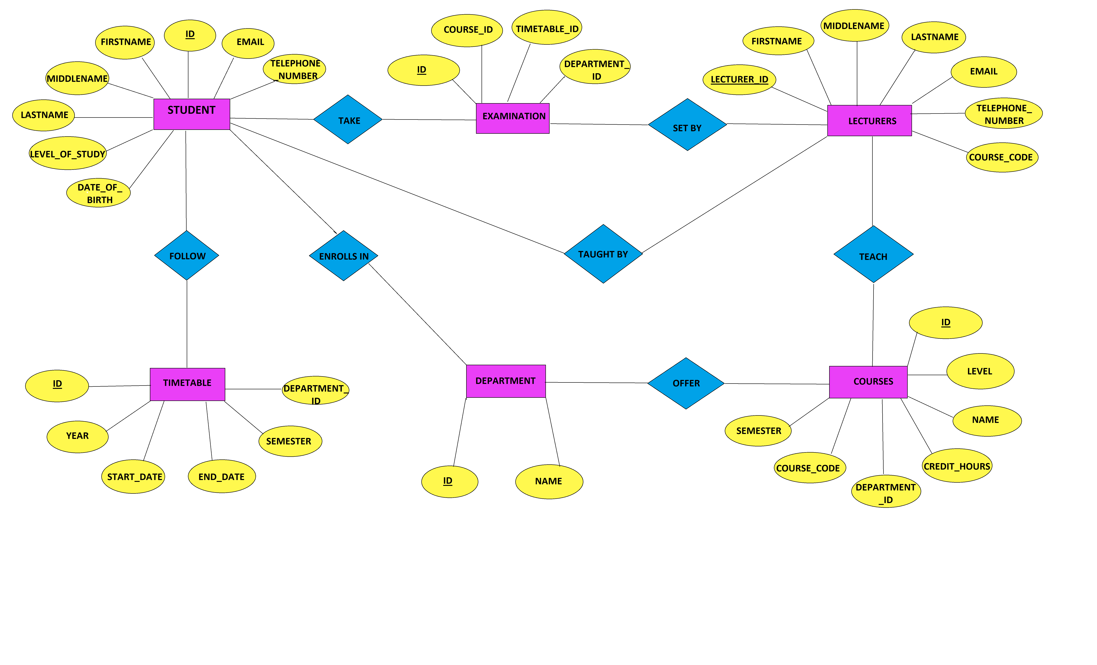
ER DIAGRAM

Slide 16
STRUCTURE OF DATABASE SCHEMA
Student(ID, firstname, middlename, lastname, date_of_birth, email, telephone_number, level_of_study)
Department(ID, name)
Course(ID, level, course_code, name, semester, credit_hours, department_id)
Lecturer(lecturer_id, firstname, middlename, lastname,email, telephone_number, course_code, department_id, event_type_event_timestamp)
Lecturer_course(id, lecturer_id, course_code)
Timetable(ID, department_id, semester, year, start_date, end_date)
Examination(ID, course_id, timetable_id, department_id)
Exam_results(ID.student_id, course_code,exam_year,exam_type, grade,remarks )
Admin(ID, name, email, telephone_number)
Course_enrollment(ID, course_id, student_id)
Examination_enrollment(ID, examination_id, student_id)
Timetable_course(ID, timetable_id, couse_id, start_time_end_time_day_of_week, location)
Login(ID, pin, user_id, last_login, failed_login_attempts, lock_until, password_reset_token, password_reset_token_expiry)

Slide 17
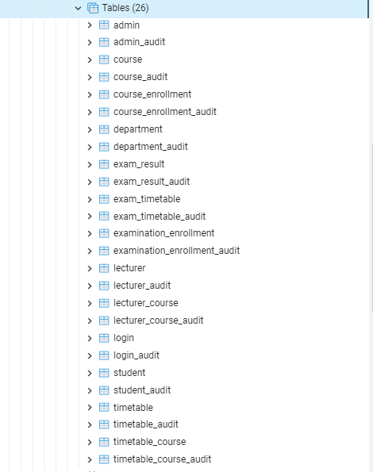
BUILDING OF THE DATABASE
ALL RELATIONS OR TABLES IN THE DATABASE

Slide 18
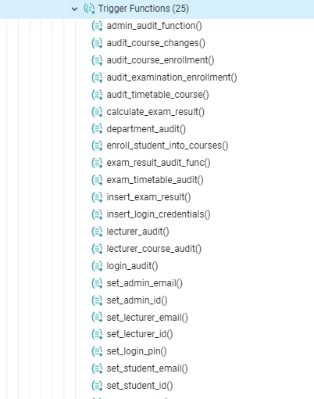
FUNCTIONS

Slide 19
DATA ENTRY INTO THE DATABASE
Data entry is the process of inputting information into the database, such as student details, course registration, and examination details. To make this process efficient, forms or interfaces will be used to collect information from students and staff.
Before we entered data into the database, we validated it for accuracy and completeness. The database system was also configured to ensure that the data entered meets the requirements specified by the school to avoid errors and inconsistencies due to some constraints and checks included in the database.
We also ensured that the information was accurate and up-to-date data is to ensure that students and staff can access the information they need in a timely and efficient manner. Inaccurate or outdated data can lead to delays and errors in various processes, which can negatively impact the Engineering School's operations.
By automating data entry in certain aspects of the database and implementing validation processes, the Engineering School can improve the quality of its data management and reduce errors and inconsistencies in data.

Slide 20
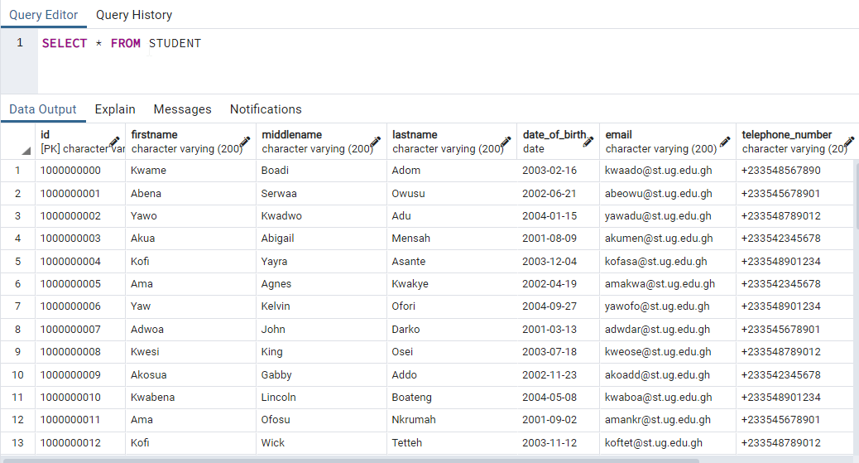
STUDENT TABLE
The ID column was automated to generate unique ids for every student.
The email field was automated to also pick the first three letters of the first name and last name to generated the appropriate email for the student.

Slide 21
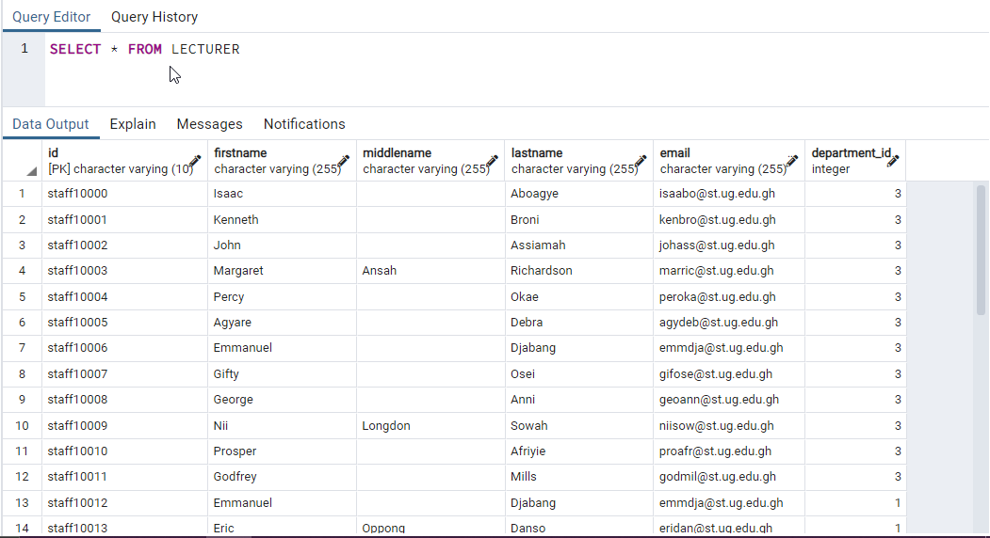
LECTURERS TABLE
The ID column was automated to generate unique ids for every lecturer.
The email field was automated to also pick the first three letters of the first name and last name to generated the appropriate email for the lecturer.

Slide 22
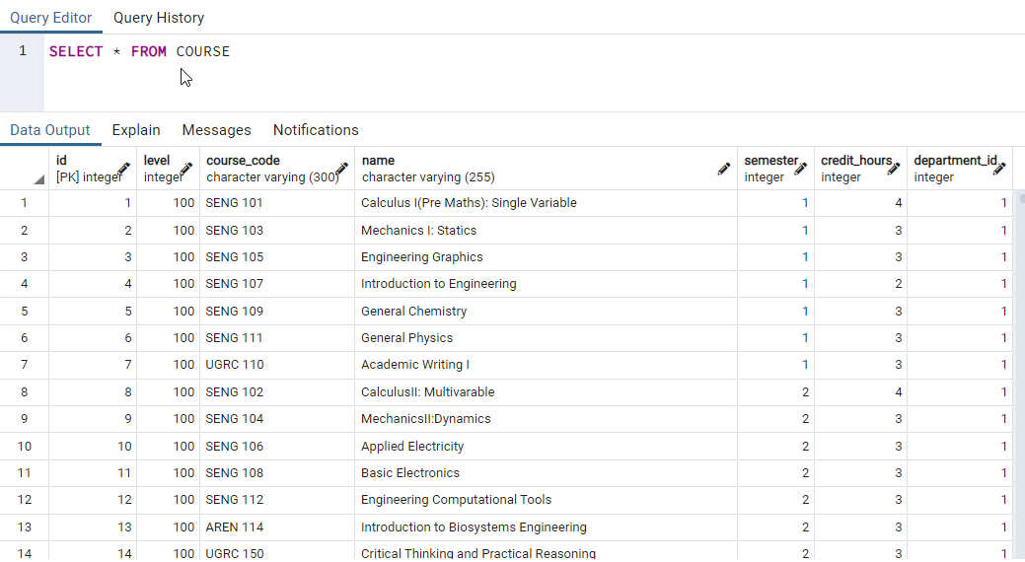
COURSE TABLE

Slide 23
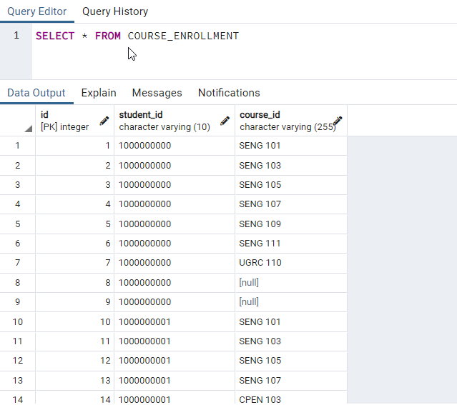
COURSE ENROLLMENT OR REGISTRATION
Students ids are automatically included in this table once they enroll in the university and their detail are in the students table
Also according to a students department the necessary courses will be assigned to the student based on the level and semester.

Slide 24
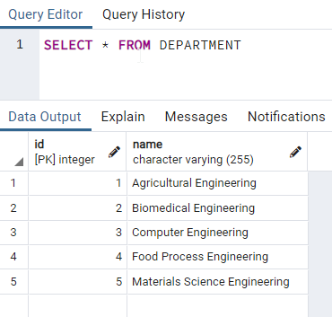
DEPARTMENT TABLE

Slide 25
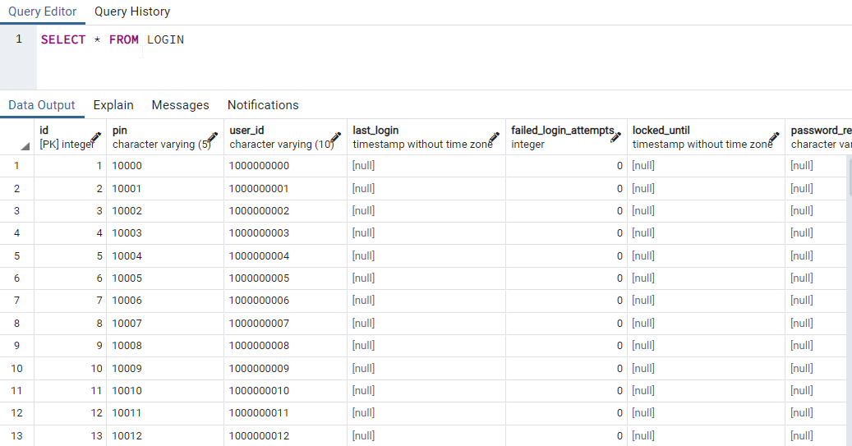
LOGIN TABLE
Once a user(lecturer, student, admin) is added to the database their ids from their respective tables is automatically imported into the login table.
A unique pin is also automatically generated for the user.
For a user to login, the user will have to enter their id and pin in the database.

Slide 26
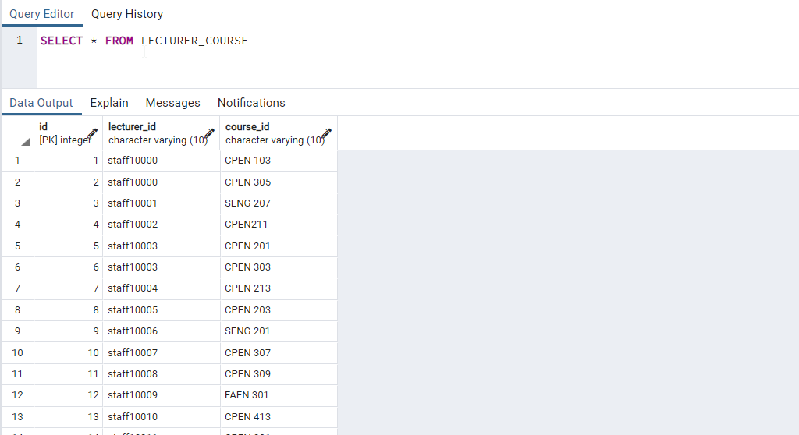
COURSES TAUGHT BY A LECTURER

Slide 27

PRINTING OF EXAMS RESULTS

Slide 28
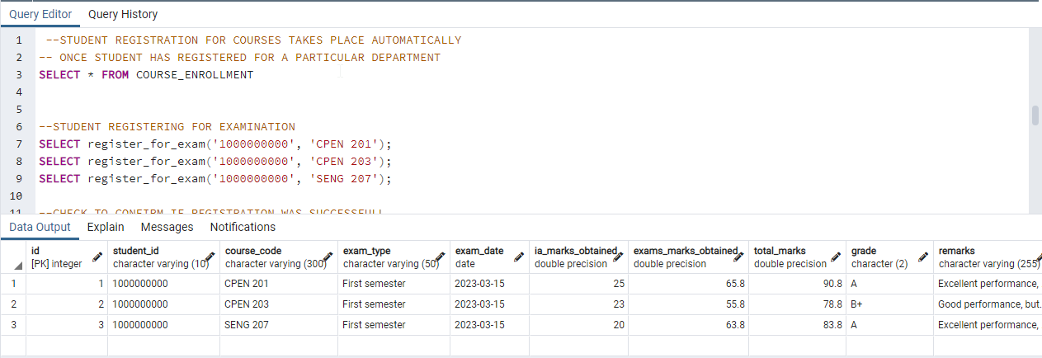
The exam_results table for the printing of results is such that:
Total marks field is automated to calculate the total marks.
Grade field also calculates the corresponding grade to the total marks
Finally, the remarks fields gives an appropriate remark for a particular mark.

Slide 29
SECURITY AND BACKUP
The security and backup of the database are critical aspects of the Engineering School project, as they ensure that the data is protected from unauthorized access, loss, or corruption. The database will be secured through a combination of measures, such as password protection and access control. Only authorized users will be granted access to the database, and their access levels will be restricted to ensure that they can only access the data that they need to perform their duties. Audit trials will help track any changes made to the database.
Backup procedures will also be put in place to ensure data integrity. Audit tables were created for each and every table to ensures lost data is not lost totally from the database.

Slide 30

TESTING THE DATABASE
AT THIS STAGE WE WILL RUN MULTIPLE QUERIES ON THE DATABASE

Slide 31
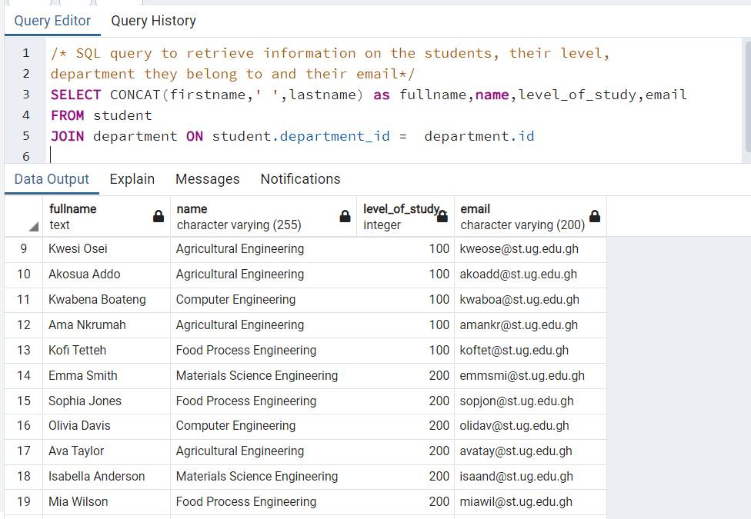
/* SQL query to retrieve information on the students, their level,department they belong to and their email*/ SELECT CONCAT(firstname,' ',lastname) as fullname,name,level_of_study,emailFROM studentJOIN department ON student.department_id = department.id

Slide 32
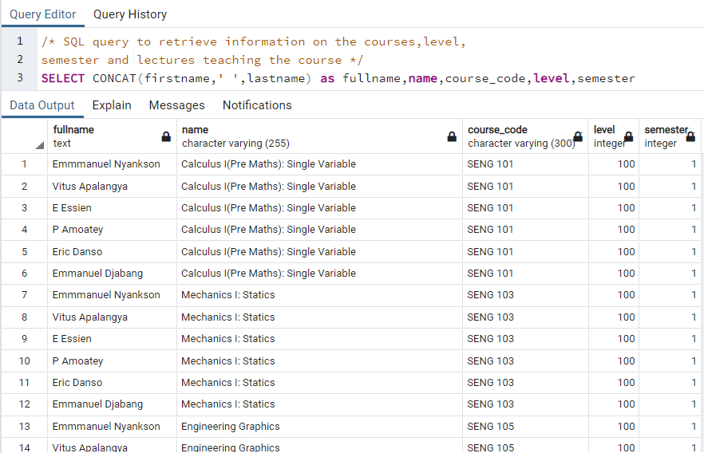
/* SQL query to retrieve information on the courses,level,semester and lectures teaching the course */ SELECT CONCAT(firstname,' ',lastname) as fullname,name,course_code,level,semesterFROM courseJOIN lecturer ON lecturer.department_id = course.department_id

Slide 33
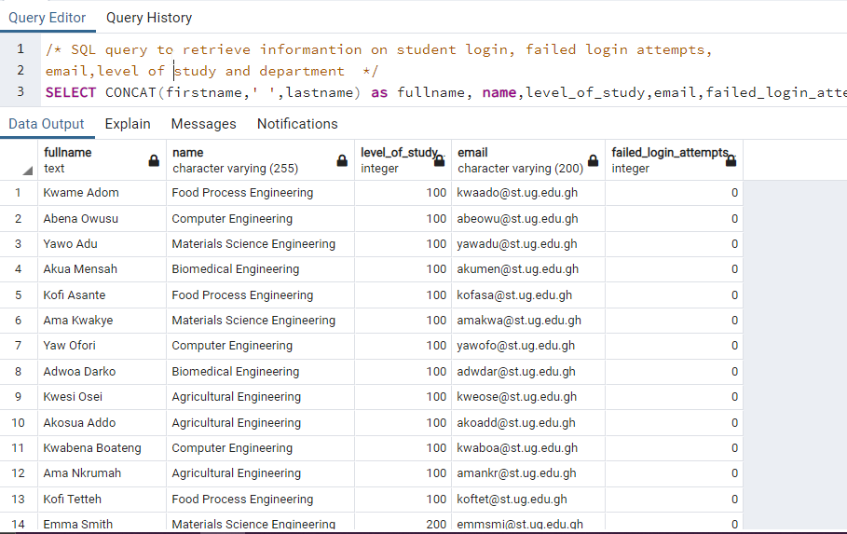
/* SQL query to retrieve informantion on student login, failed login attempts,email,level of study and department */SELECT CONCAT(firstname,' ',lastname) as fullname, name,level_of_study,email,failed_login_attemptsFROM StudentJOIN login ON login.user_id = student.idJOIN department on department.id=student.department_id

Slide 34
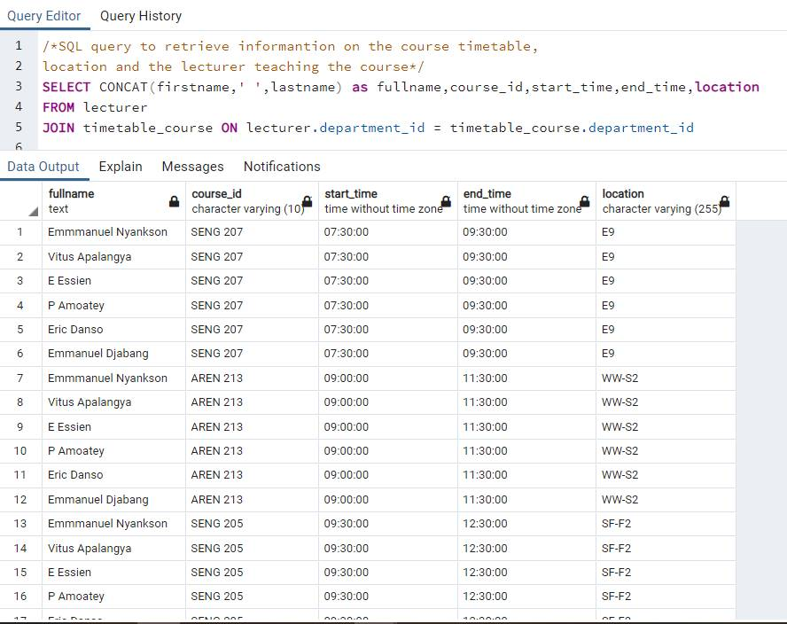
/*SQL query to retrieve informantion on the course timetable,location and the lecturer teaching the course*/SELECT CONCAT(firstname,' ',lastname) as fullname,course_id,start_time,end_time,locationFROM lecturerJOIN timetable_course ON lecturer.department_id = timetable_course.department_id

Slide 35
Conclusion
In summary, the Engineering School project was aimed to automate critical activities in the school, including capturing student details, registering courses and examinations, and creating timetables. This will improve data accuracy, reduce errors and delays, and provide a more efficient and effective service to students and staff.
The project was completed in three phases: gathering requirements and designing the database schema, implementing the database using PostgreSQL, and testing and refining the database.

Slide 36
END OF PRESENTATION

